Slide 1

Delivery & Courier using rickshaw
Group member’s
Shakil, Md Shamim
18-37431-1
Das, Arnab
19-41564-3
Islam, Raima
19-41549-3
Roy, Shithi
19-41545-3

Slide 2

INTRODUCTION
What do you mean by Delivery & Courier using rickshaw ?
Benefits of using the app for Delivery & courier purpose.

Slide 3
Target and audience of the project.
Our Target is the people who live in residential area. Our main goal is to make connection between These Areas Peoples and Shop Owners.

Slide 4
Understand the problem and need’s of the customers.
Our Project have a clear target market and audience.
Nowadays home delivery and parcel system makes our life easier. Our project make this delivery and parcel system more easier and less time consuming ,also it is cost friendly.

Slide 5
What opportunity dose it bring ?
The project “Delivery & Courier using rickshaw” begins with a purpose of making life easier, make budget and time friendly delivery environment for people of Residential area.

Slide 6
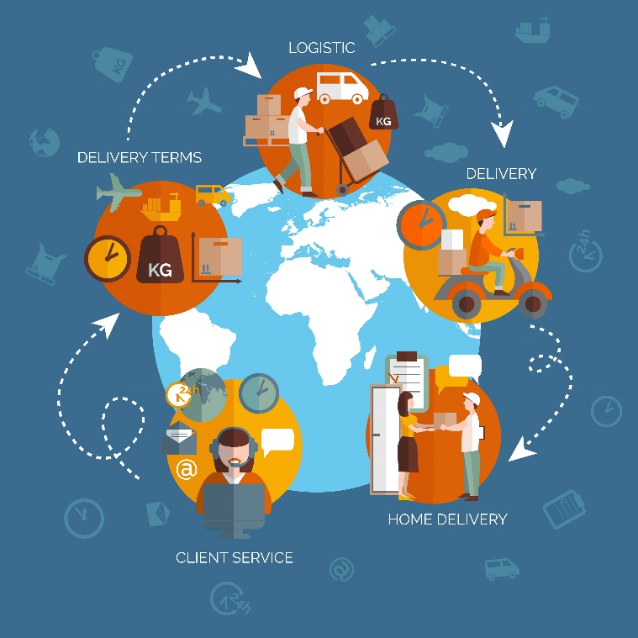
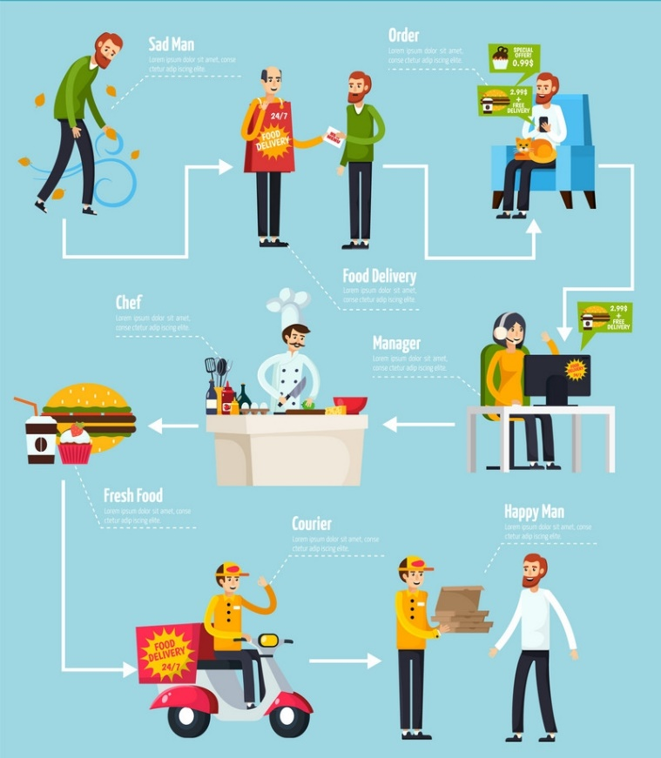
Basic and Easy functionally of the app

Slide 7
Conclusion
Purpose of the project

